Slide 1
OverFeat Part1 Tricks on Classification
By Zhang Liliang

Slide 2
Outline
Model Design and Training
Multi-Scale Classification
Results on ImageNet
ConvNets and Sliding Window Effcieny

Slide 3
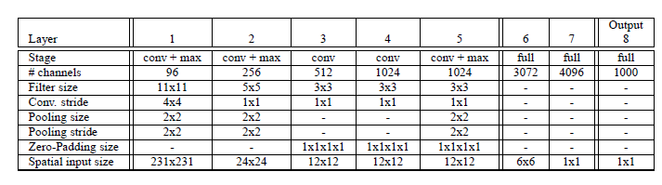
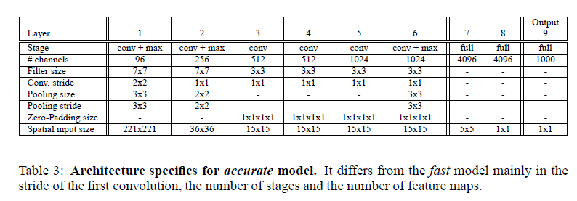
Fast Model & Accurate Model

Slide 4
AccModel vs AlexNet
No LRN
Pooling without overlap
Smaller Stride at 1st and 2nd Layer

Slide 5
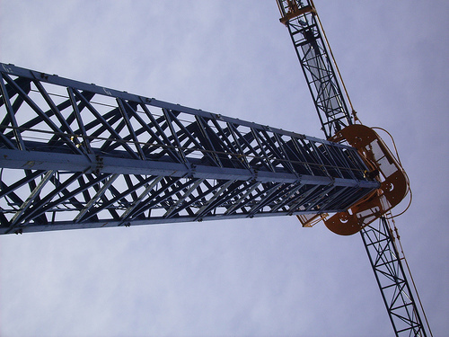
Training Details
Data Augment
downsample so that the smallest dimension is 256 pixel
extract (4 conner+1center)*2flip, each 221*221
Other train Parameter
mini-batch 128
momentum 0.6
…

Slide 6
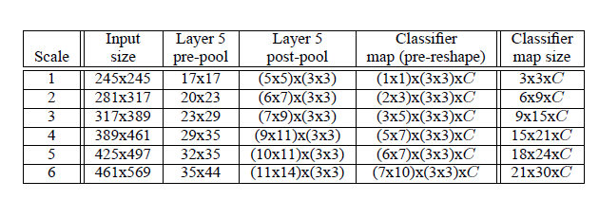
Multi-Scale Classification
While training, 1 scale(221*221).
While testing, 6 scales.
Share the same architecture

Slide 7
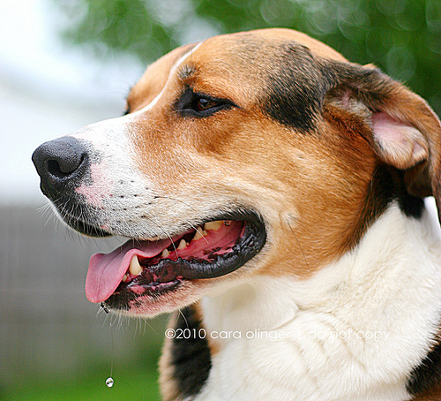
AlexNet: MultiView
10 view = (4conner+1center)* 2 horizontal flip
Weekness:
(1) ignore many region
(2) Single scale

Slide 8
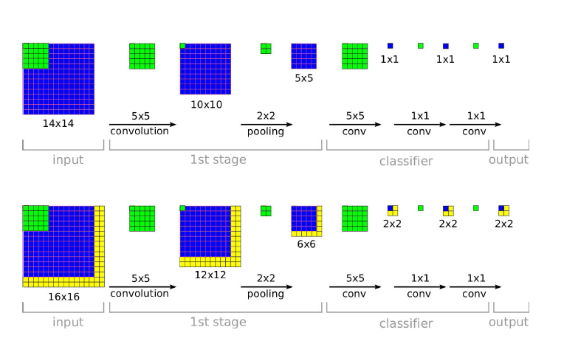
Slide Windows: MultiScale
Slide windows on orginal image: Too Expensive!!
Thus, Slide windows on the last pooling
16*16->1*1 !!

Slide 9
Slide windows on Pool5 (1)
5*5
5*5
For each scale:
6*6
5*5
5*5
5*5
5*5
6*6
Conv5:
20*20
5*5
5*5
3*3 pool
classifier
9*(2*2)*C
5*5 slide
6*6
5*5
5*5
5*5
5*5
Maximum
…….
…….
6*6
5*5
5*5
C
5*5
5*5
Total 9

Slide 10
Slide windows on Pool5 (2)
For each scale, after maximum, get a vector which length C.(C = 1000)
In OverFeat, 6 scale, with horizontal flip, thus 12 scale totally
Average the 12 vectors to get the final prediction.

Slide 11
Intuition
Example:
input 281*317
conv5 20*23
pool5 6*7
5*5 Slide windows on 6*7, stride=1
221*221 slide windows on 281 * 317, stride=10
Total windows: 9*2*3=54

Slide 12
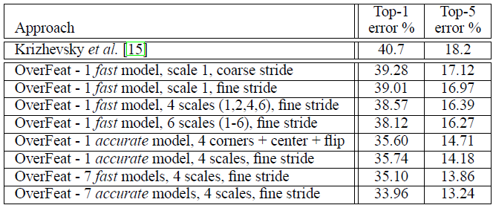
Results
2s each image.(Total 1575 test and vote for each image)
<1%, “relative small improvement”

Slide 13
Thanks

